Slide 1
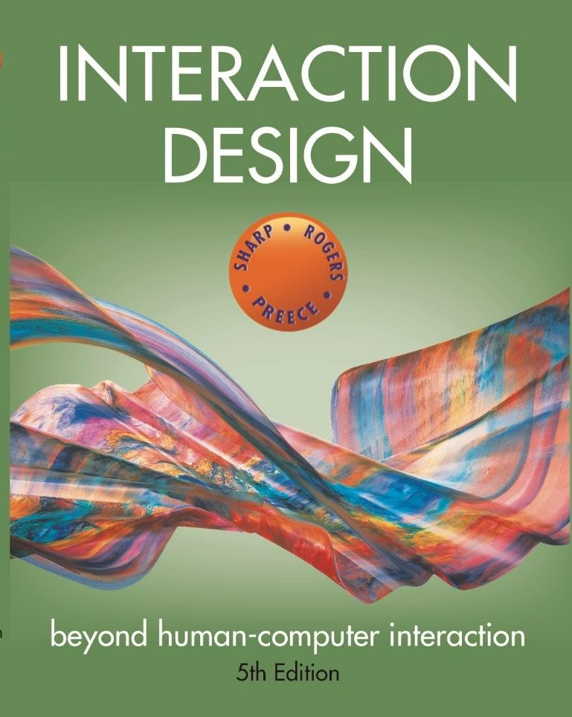
Chapter 12 DESIGN, PROTOTYPING and
CONSTRUCTION

Slide 2
Overview
Prototyping
Conceptual design
Concrete design
Using scenarios
Generating prototypes
Construction
www.id-book.com

Slide 3
Prototyping
What is a prototype?
Why prototype?
Different kinds of prototyping
Low fidelity
High fidelity
Compromises in prototyping
Vertical
Horizontal
Final product needs to be engineered
www.id-book.com

Slide 4
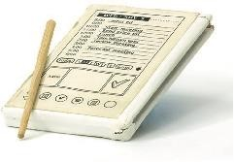
What is a prototype?
One manifestation of a design that allows stakeholders to interact with it
In other design fields, a prototype is a small-scale model:
A miniature car
A miniature building or town
Source: PalmPilot wooden model
© Mark Richards
www.id-book.com

Slide 5
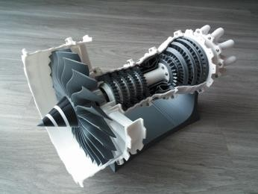
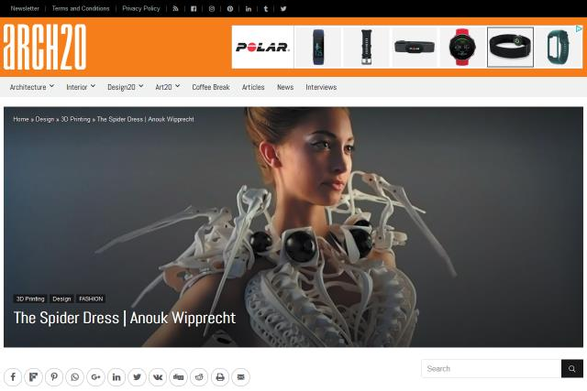
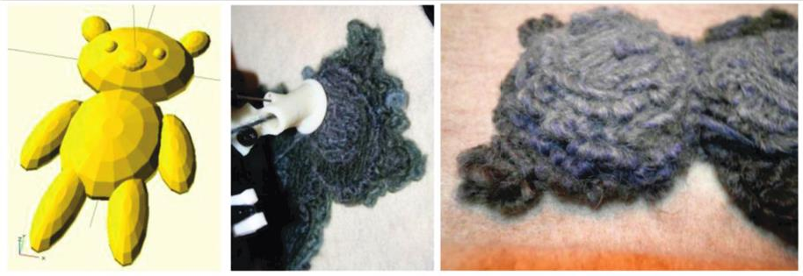
3D Printing Examples
Examples of 3D printing: (a) model jet engine, (b) Spider Dress 2.0 by Anouk
Wipprecht, and (c) teddy bear “printed” form a wireframe design
Sources: (a) Build Your Own Jet Engine. Licensed under CC-BY-3.0, (b) arch20, and (c) used courtesy of Scott Hudson
www.id-book.com

Slide 6
What is a prototype in interaction design?
In interaction design, a prototype can be (among other things):
A series of screen sketches
A storyboard, for example, a cartoon-like series of scenes
A PowerPoint slide show
A video simulating the use of a system
A lump of wood (for instance, the PalmPilot)
A cardboard mock-up
A piece of software with limited functionality written in the target language or in another language
www.id-book.com

Slide 7
Why prototype?
Evaluation and feedback are central to interaction design
Stakeholders can see, hold, and interact with a prototype more easily than a document or a drawing
Team members can communicate effectively
Ideas can be tested out
Prototyping encourages reflection: an important aspect of design
Prototypes answer questions and support designers in choosing between alternatives
www.id-book.com

Slide 8
Design-fidelity
Design fidelity refers to the level of detail and functionality included in a prototype. Fidelity can vary in interactivity, visuals, content and commands, and other areas.
When you’re getting ready to begin prototyping, you’ll need to decide how closely you want it to match the end result, which will also dictate how much time and energy you need to put into it

Slide 9
Low-fidelity Prototyping
Uses a medium which is unlike the final medium, for example, paper or cardboard
Is quick, cheap, and easily changed
Examples:
Sketches of screens, task sequences, and so on
‘Post-it’ notes
Storyboards
‘Wizard-of-Oz’
www.id-book.com

Slide 10
Storyboards
It is a series of sketches showing how a user might progress through a task using the product
Often used with scenarios, bringing in more detail and a chance to role play
www.id-book.com

Slide 11














Example storyboard
www.id-book.com

Slide 12



Sketching
Low-fidelity prototyping often relies on sketching
Don’t be inhibited about drawing ability — Practice simple symbols
www.id-book.com
14

Slide 13
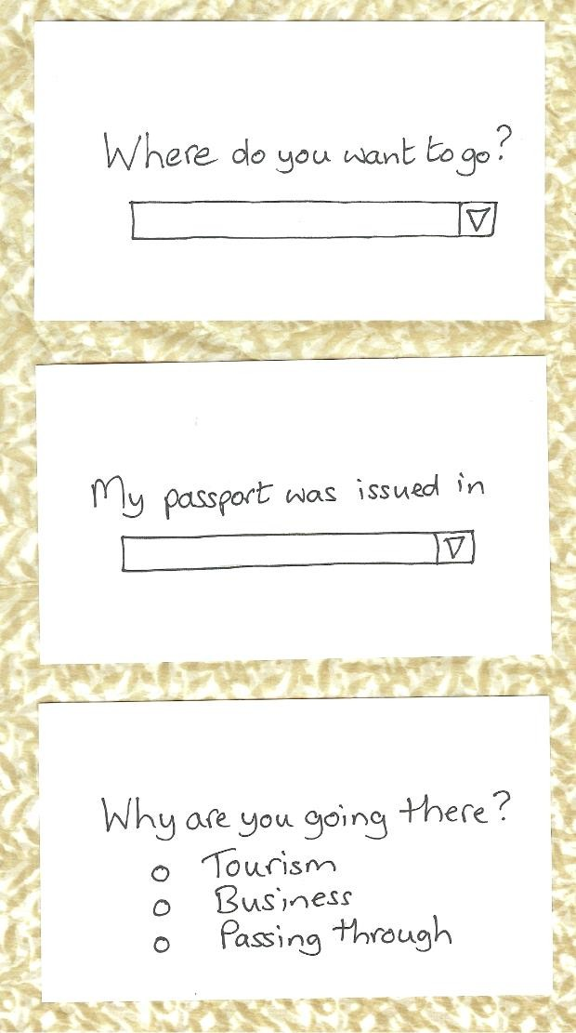
Prototyping with index cards
Index cards (3 x 5 inches)
Each card represents one element of interaction
In evaluation, can step through the cards
www.id-book.com
15

Slide 14
‘Wizard-of-Oz’ prototyping
The user thinks they are interacting with a computer, but a human is responding to output rather than the system
Usually done early in design to understand users’ expectations
It’s best used when there’s a need to simulate digital systems like websites or apps, and especially for artificial intelligence (AI) and augmented reality, as well as testing out new functionality.
What is ‘wrong’ with this approach?
https://sites.google.com/site/ioe436teamorangesassignment8/whatiswizardofoz/prosandconsofwizardofo
>Blurb blurb
>Do this
>Why?
User
www.id-book.com

Slide 15
High-fidelity prototyping
Uses materials that you would expect to be in the final product
Prototype looks more like the final system than a low- fidelity version
High-fidelity prototypes can be developed by integrating existing hardware and software components
Danger that users think they have a complete system…see compromises
www.id-book.com

Slide 16
Compromises in prototyping
Prototyping involve compromises
For software-based prototyping, maybe there is a slow response? sketchy icons? limited functionality?
“In the wild” prototypes operational but not necessarily robust
Two common types of compromise:
Horizontal: Provides a wide range of functions, but with little detail
Vertical: Provides a lot of detail for only a few
functions
Compromises in prototypes must not be ignored. Product needs engineering
www.id-book.com

Slide 17
Conceptual design
A conceptual model is an outline of what people can do with a product and what concepts are needed to understand and interact with it
Understand problem space and current requirements; empathize with users
Creativity and brainstorming techniques
Mood board may capture desired feel
Consider alternatives: scenarios and prototyping helps
www.id-book.com

Slide 18

Building scenarios
www.id-book.com

Slide 19
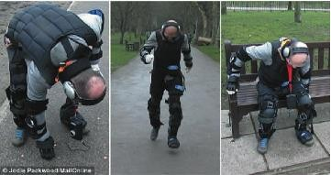
Empathizing with users
The Third Age Suit
Source: Ford Motor Company
www.id-book.com

Slide 20
Choosing an interface metaphor
Interface metaphors combine familiar knowledge with new knowledge in a way that will help the user understand the product.
Three steps: understand functionality, identify potential
problem areas, and generate metaphors
Evaluate metaphors:
How much structure does it provide?
How much is relevant to the problem?
Is it easy to represent?
Will the audience understand it?
How extensible is it?
www.id-book.com

Slide 21
Considering interaction and interface types
Which interaction type?
How the user invokes actions
Instructing, conversing, manipulating, exploring, or responding
Do different interface types provide insight?
Shareable, tangible, augmented reality, and so forth
www.id-book.com

Slide 22
Expanding the initial conceptual model
What functions will the product perform?
What will the product do and what will the human do?
How are the functions related to each other?
Sequential or parallel?
Categorizations, for example, all actions related to privacy on a smartphone
What information is needed?
What data is needed to perform the task?
How is this data to be transformed by the system?
www.id-book.com

Slide 23
Concrete design
Difference between conceptual and concrete is emphasis
Many aspects to concrete design
Color, icons, buttons, interaction devices, and so on
User characteristics and context
Inclusiveness, input, and output modes
Accessibility
Web Content Accessibility Guidelines
Cross-cultural design
Language, colors, icons, and information architecture
Indigenous knowledge and perspectives
www.id-book.com

Slide 24
Generating prototypes
Generate a storyboard from a scenario
Break down scenario into steps
Create a scene for each step
Sketching out a storyboard prompts designers to think about design issues
Generate a card-based prototype from a storyboard or from a use case
Consider each step in use case – what interaction element is needed
Draw a card that captures it
www.id-book.com

Slide 25
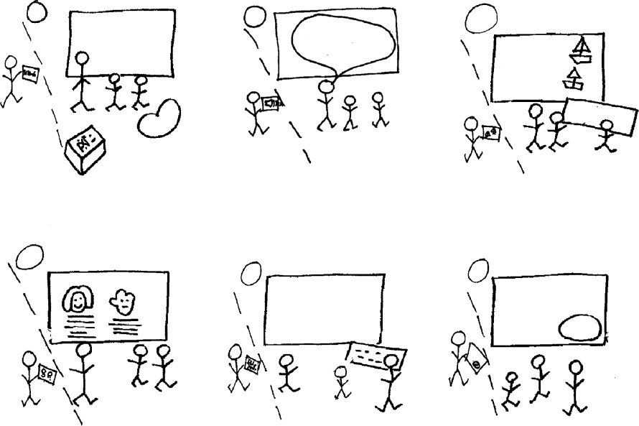









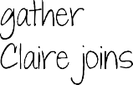





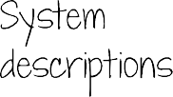


Generating storyboard
www.id-book.com

Slide 26

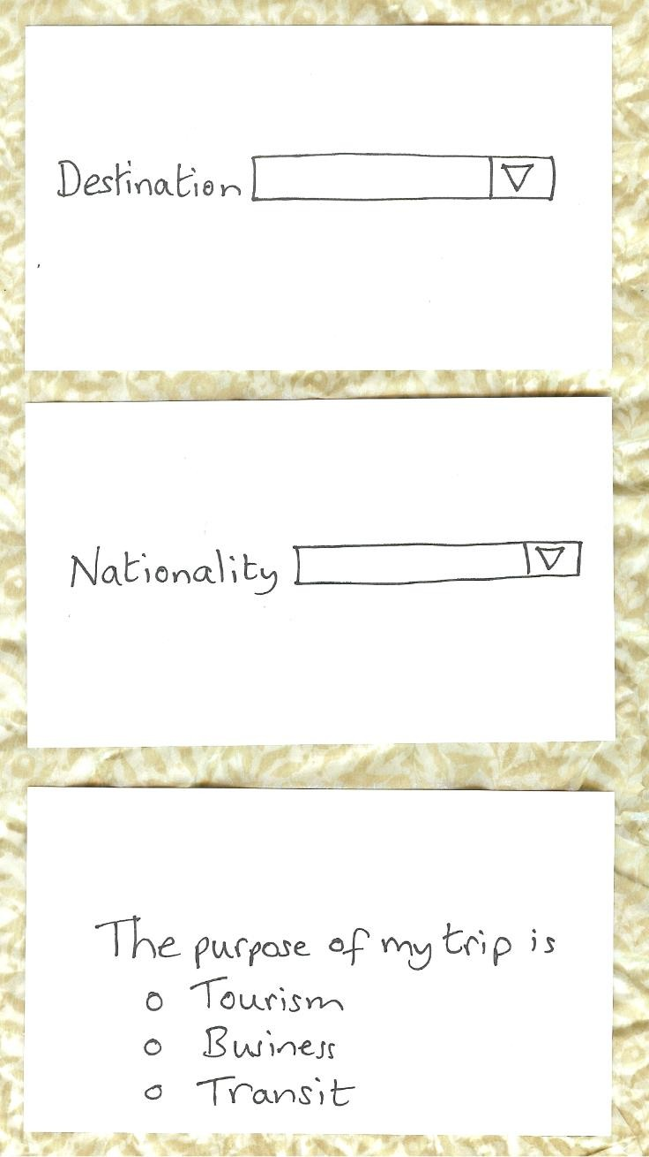
Generating card-based prototype
www.id-book.com

Slide 27
Explore the user’s experience
Use personas, card-based prototypes, or stickies to model the user experience
Visual representation called:
Design map
Customer or user journey map
Experience map
Two common representations
Wheel
Timeline
www.id-book.com
27

Slide 28
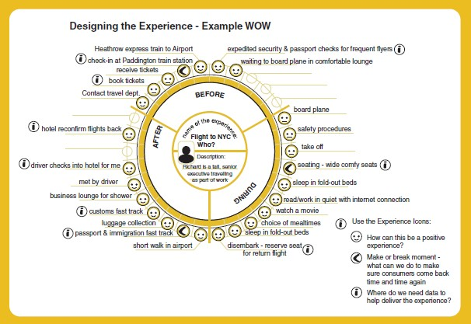
An experience map drawn as a wheel
Source: LEGO
www.id-book.com
28

Slide 29
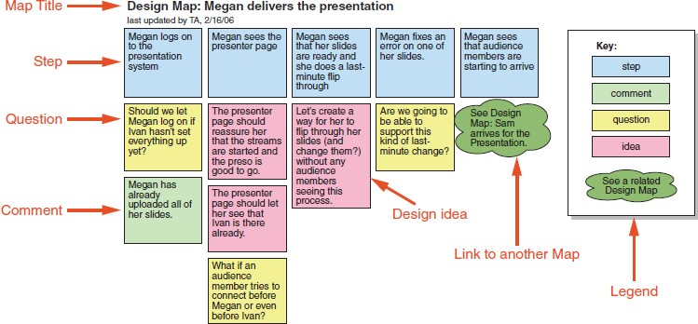
An experience map drawn as a timeline
Source: Adlin and Pruitt (2010), p134. Used courtesy of Morgan Kaufmann.
www.id-book.com
29

Slide 30
Construction: Physical computing
Build and code prototypes using electronics
Toolkits available include
Arduino
LilyPad (for fabrics)
Senseboard
BBC micro:bit
MaKey MaKey
Designed for use by wide range of people
www.id-book.com
30

Slide 31
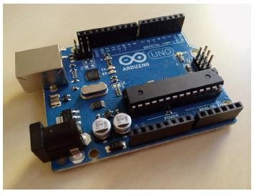
Physical computing kits
The Arduino board
Source: Used courtesy of Dr. Nicolai Marquardt
www.id-book.com
31

Slide 32
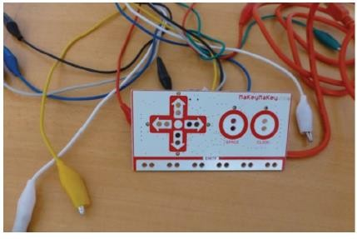
Physical computing kits
The Makey Makey toolkit
Source: Makey Makey
www.id-book.com
32

Slide 33
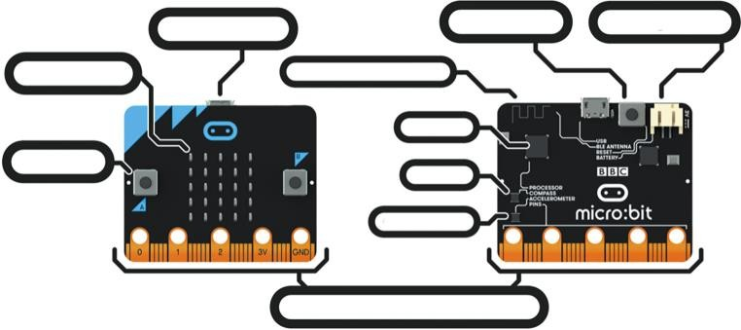
Physical computing kits
The BBC micro:bit
Source: micro:bit. Used courtesy of Micro:bit Foundation
www.id-book.com
33

Slide 34
Construction: SDKs
Software Development Kits
Programming tools and components to develop for a specific platform, for example, iOS
Includes: IDE, documentation, drivers, sample code, and application programming interfaces (APIs)
Makes development much easier
Examples:
Amazon’s Alexa Skills Kit for voice-based services
Apple’s ARKit for augmented reality
Microsoft’s Kinect SDK for motion tracking
www.id-book.com
34

Slide 35
Summary
Prototyping may be low fidelity (such as paper- based) or high fidelity (such as software-based)
Existing software and hardware helps create prototypes
Two aspects to design: conceptual and concrete
Conceptual design develops an outline of what users can do and what concepts are needed to understand the product.
Concrete design specifies design details, for example, layout or navigation
www.id-book.com

Slide 36
Summary (continued)
Three approaches to develop an initial conceptual model: interface metaphors, interaction styles, and interface styles.
Expand an initial conceptual model by considering whether product or user performs each function, how those functions are related, and what information is required to support them
Generate prototypes from scenarios and use cases
Physical computing kits and software development kits facilitate the transition from design to construction
www.id-book.com

